Slide 1
Subtopic N3.2 – Mental Strategies for Multiplication and Division
Learning outcome: To recall mental multiplication and division facts
Keywords:
Multiply
Divide
Product
Objectives:
To recall multiplication facts up to 12 x 12
To recall division facts up to divisors of 12
Introduction – read and annotate:
In this subtopic, you'll develop strategies to become faster and more fluent with mental multiplication
and division. Being able to quickly work out answers in your head helps with everything from
estimating to solving more complex problems with confidence.
Definition
Characteristics
Repeated addition of the same number.
Often represented by the "×" sign.
Commutative
Distributive property: Multiplication can be distributed over addition. For example, 3 × (2 + 4) is the same as (3 × 2) + (3 × 4), both equal 18
Examples
Multiplication
Non - Examples
If you have 3 groups of 4 apples, you can use multiplication to find the total number of apples by calculating 3 × 4, which equals 12.
Sarah has 12 cookies. She wants to share them equally among 4 friends. How many cookies will each friend get? This is a division problem.
Mental multiplication
Steps | Example 1 - I do | Example 2 - We do | Example 3 - You do…
List each number in the times table, starting with multiplying by 1. To work out the next number, add on the number of the times table you are working with. | Write out the fact series for the two times table, up to 2 x 12. 2 x 1 = ______ 2 x 2 = ______ 2 x 3 = ______ 2 x 4 = ______ 2 x 5 = ______ 2 x 6 = ______ 2 x 7 = ______ 2 x 8 = ______ 2 x 9 = ______ 2 x 10 = ______ 2 x 11 = ______ 2 x 12 = ______ | Write out the fact series for the six times table, up to 6 x 12. 6 x ______ = ______ 6 x ______ = ______ 6 x ______ = ______ 6 x ______ = ______ 6 x ______ = ______ 6 x ______ = ______ 6 x ______ = ______ 6 x ______ = ______ 6 x ______ = ______ 6 x ______ = ______ 6 x ______ = ______ 6 x ______ = ______ | Write out the fact series for the four times table, up to 4 x 12. ______ x ______ = ______ ______ x ______ = ______ ______ x ______ = ______ ______ x ______ = ______ ______ x ______ = ______ ______ x ______ = ______ ______ x ______ = ______ ______ x ______ = ______ ______ x ______ = ______ ______ x ______ = ______ ______ x ______ = ______ ______ x ______ = ______
2
4
6
8
10
12
14
16
18
20
22
24
1
2
3
4
5
6
7
8
9
10
11
12
6
12
18
24
30
36
42
48
54
60
66
72
4
4
4
4
4
4
4
4
4
4
4
4
1
2
3
4
5
6
7
8
9
10
11
12
4
8
12
16
20
24
28
32
36
40
44
48
Notes:
Practice rolling numbers. Get scholars to say the table without looking.
Do some MWB practice.

Slide 2
Independent Practice
1. Write out the fact series for the:
a) Three times table | b) Seven times table | c) One times table
______ x ______ = ______ ______ x ______ = ______ ______ x ______ = ______ ______ x ______ = ______ ______ x ______ = ______ ______ x ______ = ______ ______ x ______ = ______ ______ x ______ = ______ ______ x ______ = ______ ______ x ______ = ______ ______ x ______ = ______ ______ x ______ = ______ | ______ x ______ = ______ ______ x ______ = ______ ______ x ______ = ______ ______ x ______ = ______ ______ x ______ = ______ ______ x ______ = ______ ______ x ______ = ______ ______ x ______ = ______ ______ x ______ = ______ ______ x ______ = ______ ______ x ______ = ______ ______ x ______ = ______ | ______ x ______ = ______ ______ x ______ = ______ ______ x ______ = ______ ______ x ______ = ______ ______ x ______ = ______ ______ x ______ = ______ ______ x ______ = ______ ______ x ______ = ______ ______ x ______ = ______ ______ x ______ = ______ ______ x ______ = ______ ______ x ______ = ______
3
3
3
3
3
3
3
3
3
3
3
3
1
2
3
4
5
6
7
8
9
10
11
12
3
6
9
12
15
18
21
24
27
30
33
36
7
7
7
7
7
7
7
7
7
7
7
7
1
2
3
4
5
6
7
8
9
10
11
12
7
14
21
28
35
42
49
56
63
70
77
84
1
1
1
1
1
1
1
1
1
1
1
1
1
2
3
4
5
6
7
8
9
10
11
12
1
2
3
4
5
6
7
8
9
10
11
12
d) Nine times table | e) Twelve times table | f) Five times table
______ x ______ = ______ ______ x ______ = ______ ______ x ______ = ______ ______ x ______ = ______ ______ x ______ = ______ ______ x ______ = ______ ______ x ______ = ______ ______ x ______ = ______ ______ x ______ = ______ ______ x ______ = ______ ______ x ______ = ______ ______ x ______ = ______ | ______ x ______ = ______ ______ x ______ = ______ ______ x ______ = ______ ______ x ______ = ______ ______ x ______ = ______ ______ x ______ = ______ ______ x ______ = ______ ______ x ______ = ______ ______ x ______ = ______ ______ x ______ = ______ ______ x ______ = ______ ______ x ______ = ______ | ______ x ______ = ______ ______ x ______ = ______ ______ x ______ = ______ ______ x ______ = ______ ______ x ______ = ______ ______ x ______ = ______ ______ x ______ = ______ ______ x ______ = ______ ______ x ______ = ______ ______ x ______ = ______ ______ x ______ = ______ ______ x ______ = ______
9
9
9
9
9
9
9
9
9
9
9
9
1
2
3
4
5
6
7
8
9
10
11
12
9
18
27
36
45
54
63
72
81
90
99
108
12
12
12
12
12
12
12
12
12
12
12
12
1
2
3
4
5
6
7
8
9
10
11
12
12
24
36
48
60
72
84
96
108
120
132
144
5
5
5
5
5
5
5
5
5
5
5
5
1
2
3
4
5
6
7
8
9
10
11
12
5
10
15
20
25
30
35
40
45
50
55
60

Slide 3

g) Eight times table | h) Ten times table | i) Eleven times table
______ x ______ = ______ ______ x ______ = ______ ______ x ______ = ______ ______ x ______ = ______ ______ x ______ = ______ ______ x ______ = ______ ______ x ______ = ______ ______ x ______ = ______ ______ x ______ = ______ ______ x ______ = ______ ______ x ______ = ______ ______ x ______ = ______ | ______ x ______ = ______ ______ x ______ = ______ ______ x ______ = ______ ______ x ______ = ______ ______ x ______ = ______ ______ x ______ = ______ ______ x ______ = ______ ______ x ______ = ______ ______ x ______ = ______ ______ x ______ = ______ ______ x ______ = ______ ______ x ______ = ______ | ______ x ______ = ______ ______ x ______ = ______ ______ x ______ = ______ ______ x ______ = ______ ______ x ______ = ______ ______ x ______ = ______ ______ x ______ = ______ ______ x ______ = ______ ______ x ______ = ______ ______ x ______ = ______ ______ x ______ = ______ ______ x ______ = ______
8
8
8
8
8
8
8
8
8
8
8
8
1
2
3
4
5
6
7
8
9
10
11
12
8
16
24
32
40
48
56
64
72
80
88
96
10
10
10
10
10
10
10
10
10
10
10
10
1
2
3
4
5
6
7
8
9
10
11
12
10
20
30
40
50
60
70
80
90
100
110
120
11
11
11
11
11
11
11
11
11
11
11
11
1
2
3
4
5
6
7
8
9
10
11
12
11
22
33
44
55
66
77
88
99
110
121
132

Slide 4
2. Complete the following multiplication grids:
a) | b)
d) | e)
g) | h)
i) | j)
x | 2 | 5 | 10
3
4
6
x | 3 | 4 | 7
2
6
8
6 15 30
6 8 14
8 20 40
18 24 42
12 30 60
24 32 56
x | 6 | 1 | 9
5
7
8
x | 8 | 3 | 7
7
5
8
30 5 45
56 21 49
42 7 63
40 15 35
48 8 72
64 24 56
x | 12 | 4 | 10
9
3
1
x | 11 | 7 | 9
1
10
2
108 36 90
11 7 9
36 12 30
110 70 90
12 4 10
22 14 18
x | 11 | 7 | 9
5
8
12
x | 12 | 8 | 6
5
8
12
55 35 45
60 40 30
88 56 72
96 64 48
132 84 108
144 96 72

Slide 5
k) | l)
m) For every row or column being multiplied by 1, what did you notice?
n) For every row or column being multiplied by 0, what did you notice?
x | 7 | 0 | 9
5
1
11
x | 3 | 12 | 1
4
8
0
35 0 45
12 48 4
7 0 9
24 96 8
77 0 99
0 0 0
The number being multiplied by one stays the same
The answer is always 0
Exploring multiplying by 1 and 0
Steps | Example 4 - I do | Example 5 - We do | Example 6 - You do…
Work through the times table in descending order. Spot the pattern for multiplying by 1 and for multiplying by 0. | Complete the following ‘2 times’ facts: 2 x 3 = ______ 2 x 2 = ______ 2 x 1 = ______ 2 x 0 = ______ | Complete the following ‘7 times’ facts: 7 x 3 = ______ 7 x 2 = ______ 7 x ______ = ______ 7 x ______ = ______ | Complete the following ‘9 times’ facts: 9 x 3 = ______ 9 x 2 = ______ 9 x ______ = ______ 9 x ______ = ______
6
4
2
0
21
14
7
0
27
18
9
0
1
0
1
0
When multiplying any number by 1, the number stays __________________________________ .
When multiplying any number by 0, the answer will always be ______________________________ .
The same
0

Slide 6
Independent Practice
3. Calculate the following:
a) 7 x 1 | b) 76 x 1 | c) 765 x 1 | d) 567 x 1 | e) 76501 x 1
f) 9 x 0 | g) 19 x 0 | h) 191 x 0 | i) 911 x 0 | j) 91919191 x 0
7 76 765 567 76501
0 0 0 0 0
Mental multiplication practice and the commutative law
Example 7 - I do | Example 8 - We do | Example 9 - You do…
Complete the multiplication fact below: Using the commutative law, write the other multiplication fact: | Complete the multiplication fact below: Using the commutative law, write the other multiplication fact: | Complete the multiplication fact below: Using the commutative law, write the other multiplication fact:
3 7
21
8 4
32
5 9
45
7 3
21
4 8
32
9 5
45
Independent Practice
4. Complete the first multiplication fact and write the second multiplication fact using the commutative law
a) | b) | c)
5 6
30
8 7
56
4 7
28
6 5
30
7 8
56
7 4
28

Slide 7
d) | e) | f)
g) | h) | i)
j) | k) | l)
j) | k) | l)
3 6
18
7 8
56
4 7
28
6 3
18
8 7
56
7 4
28
11 3
33
12 9
108
9 8
72
3 11
33
9 12
108
8 9
72
4 11
44
5 3
15
10 6
60
11 4
44
3 5
15
6 10
60
0 12
0
9 1
9
9 7
63
12 0
0
1 9
9
7 9
63

Slide 8
Definition
Characteristics
Division is the arithmetical process of dividing one number into another number.
Involves two numbers: dividend and divisor.
The result of division is called the quotient.
Can result in a whole number, a fraction, or a decimal, depending on the numbers involved.
Denoted by the symbol "÷" or the fraction bar "⁄“
Not commutative
Examples
DIVISION
Non - Examples
10 ÷ 2 = 5
8 ÷ 4 = 2
21 ÷ 7 = 3
1.5 ÷ 0.5 = 3
Addition & subtraction are not division operations.
Multiplication is the inverse of division but is a different operation.
Ratios and proportions are related concepts but are not division.
Mental division
Steps | Example 10 - I do | Example 11 - We do | Example 12 - You do…
Identify how many times the divisor goes into the dividend.
5
4
4
8
8
9
3
9
5
4
7
5
7
7
5
Independent Practice
5. Answer the following division questions.
a) | b) | c) | d)
e) | f) | g) | h)
i) | j) | k) | l)
4 8 11 12
1 6 7 2
12 8 10 11

Slide 9
m) | n) | o) | p)
q) | r) | s) | t)
u) | v) | w) | x)
y) | z) | aa) | ab)
ac) | ad) | ae) | af)
ag) | ah) | ai) | aj)
ak) | al) | am) | an)
ao) | ap) | aq) | ar)
as) | at) | au) | av)
aw) | ax) | ay) | az)
ba) | bb) | bc) | bd)
be) | bf) | bg) | bh)
bi) | bj) | bk) | bl)
bm) | bn) | bo) | bp)
bq) | br) | bs) | bt)
10 8 3 12
10 12 10 1
5 2 11 9
3 1 12 6
7 2 7 9
12 10 6 11
2 6 12 4
1 11 9 8
10 12 9 4
5 5 9 6
2 1 3 7
8 10 4 12
5 11 2 3
7 9 12 2
6 12 7 3

Slide 10
bu) For every division where the number was divided by itself, what did you notice? The answer is 1
bv) For every division where the divisor was 1, what did you notice? The dividend (the number you started with) stays the same
Exploring dividing by 1 and the dividend itself
Example 13 - I do | Example 14 - We do | Example 15 - You do…
12
1
7
1
11
1
When dividing any number by 1, the number stays __________________________________ .
When dividing any number by itself, the answer will always be ______________________________ .
The same
1
Independent Practice
6. Calculate the following:
a) 7 ÷ 1 | b) 76 ÷ 1 | c) 765 ÷ 1 | d) 567 ÷ 1 | e) 76501 ÷1
f) 9 ÷ 9 | g) 19 ÷ 19 | h) 191 ÷ 191 | i) 911 ÷ 911 | j) 91919 ÷ 91919
7 76 765 567 76501
1 1 1 1 1

Slide 11




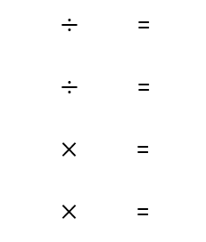
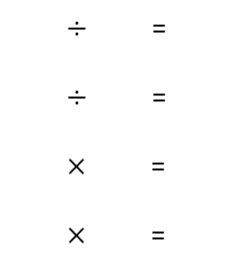
Number families with multiplication and division
Example 16 - I do | Example 17 - We do | Example 18 - You do…
Write the number families from the bar models given
10
14
20
5 5
2 2 2 2 2 2 2
4 4 4 4 4
10 2 5
10 5 2
14 7 2
14 2 7
20 5 4
20 4 5
2 5 10
5 2 10
7 2 14
2 7 14
5 4 20
4 5 20
Independent Practice.
7. Write the number families from the bar models given
a)
b)
c)
d)
60
36
6
4
12 12 12 12 12
4 4 4 4
2 2 2
1 1 1 1
60 5 12
60 12 5
36 4 9
36 9 4
6 3 2
6 2 3
4 4 1
4 1 4
5 12 60
12 5 60
4 9 36
9 4 36
3 2 6
2 3 6
4 1 4
1 4 4
e)
f)
g)
h)
45
45
64
28
9 9 9 9 9
5 5 5 5 5 5 5 5 5
7 7 7 7
8 8 8 8 8 8 8 8
45 5 9
45 9 5
45 9 5
45 5 9
64 8 8
64 8 8
28 4 7
28 7 4
5 9 45
9 5 45
9 5 45
5 9 45
8 8 64
8 8 64
4 7 28
7 4 28

Slide 12
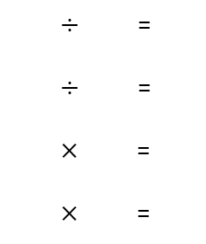
i)
j)
k)
l)
40
40
16
16
5 5 5 5 5 5 5 5
10 10 10 10
8 8
2 2 2 2 2 2 2 2
40 8 5
40 5 8
40 4 10
40 10 4
16 8 2
16 2 8
16 2 8
16 8 2
8 5 40
5 8 40
4 10 40
10 4 40
8 2 16
2 8 16
2 8 16
8 2 16
m)
n)
o)
p)
36
36
3
3
12 12 12
6 6 6 6 6 6
3
1 1 1
36 3 12
36 12 3
36 6 6
36 6 6
3 3 1
3 3 1
3 1 3
3 3 1
3 12 36
12 3 36
6 6 36
6 6 36
1 3 3
3 1 3
1 3 3
3 1 3
q)
r)
s)
t)
54
21
90
90
54 9 6
54 6 9
21 7 3
21 3 7
90 10 9
90 9 10
90 9 10
90 10 9
9 6 54
6 9 54
7 3 21
3 7 21
10 9 90
9 10 90
9 10 90
10 9 90

Slide 13
8. For each statement, decide whether it is always, sometimes or never true.
a) When you multiply two numbers together, it doesn’t matter which order you do it in. | Always true
b) Divide means ‘shared between’ | Always true
c) There are more than ten positive integer multiplication sums that give the answer 6. | Never true
d) When you divide one number by another, it doesn’t matter which order you do it in. | Sometimes true – it doesn’t matter if both numbers are the same (e.g. 2 divided by 2) but false in all other cases
e) Multiplying a number by zero doesn’t change the number. | Sometimes true, in the case of 0 x 0. Otherwise, false.
f) You can undo a multiplication by dividing. | Always true
g) a x b = b x a | Always true
h) a x ( b x c) = (a x b) x c | Always true
i) a ÷ b = b ÷ a | Sometimes true, in the case of a = b. False in all other cases.

Slide 14
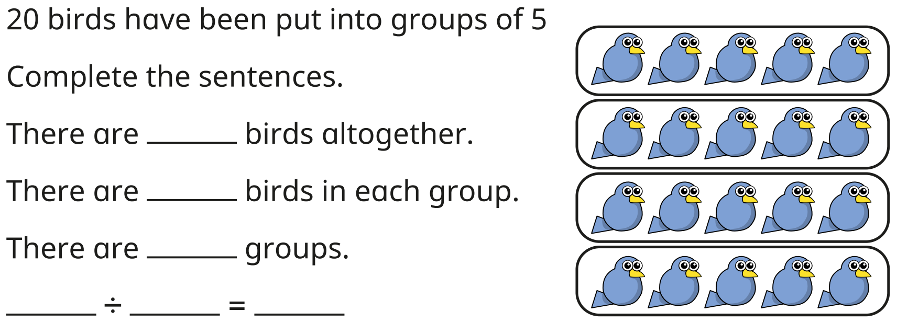
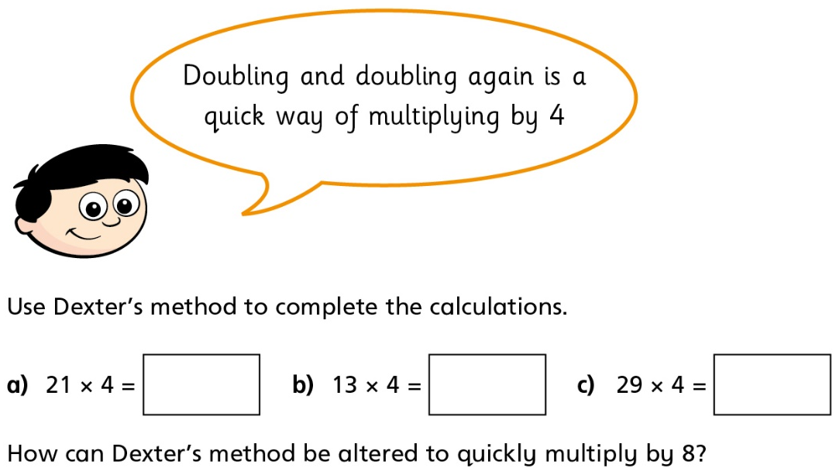
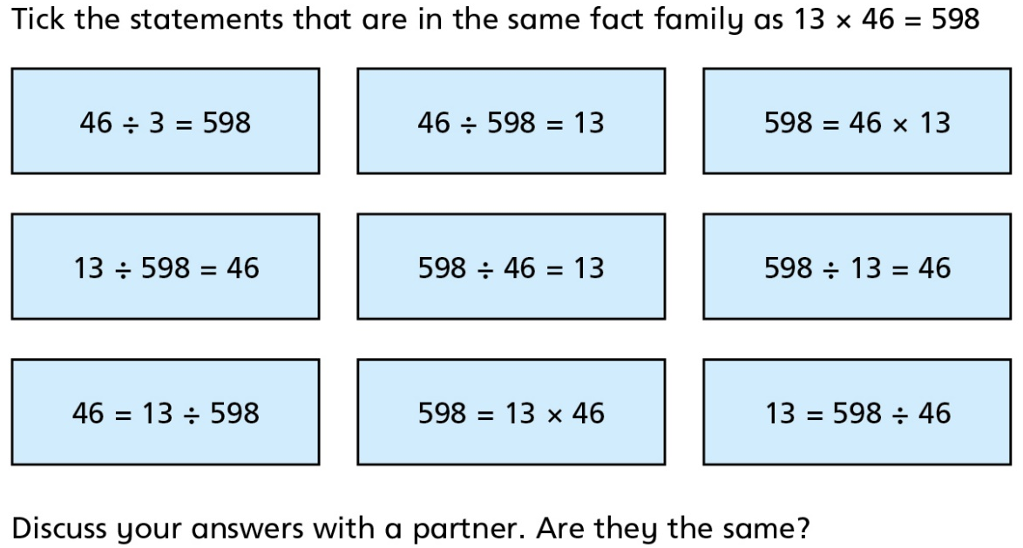
9.
20
5
4
20 4 5
10.
84 52 116
Double one more time
11.
✓
✓
✓
✓
✓
‹#›

Slide 15
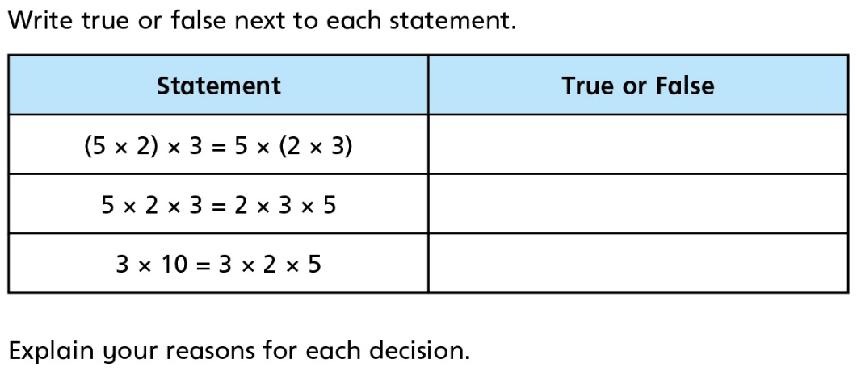
12.
T T T
Associative
Commutative
2 x 5 = 10
Skills Check
Work out 12 multiplied by 4 A. 48 B. 16 C. 3 D. 44 | 2. Calculate the value of 8 x 9 A. 81 B. 72 C. 32 D. 71
3. Calculate 56 ÷ 7 A. 7 B. 49 C. 63 D. 8 | ? ÷ 7 = 4 A. 11 B. 28 C. 3 D. 1

